Slide 1
Housing Finance Reform
August 2017

Slide 2
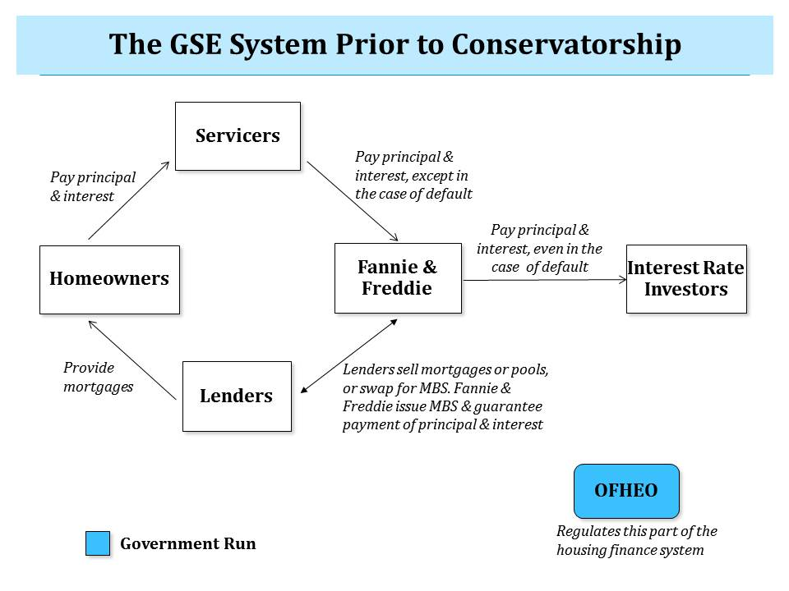
THE HOUSING FINANCE SYSTEM PRIOR TO GSE CONSERVATORSHIP
The fundamental flaw in the architecture of the previous Housing Finance system was its reliance on the privately owned duopoly of Fannie Mae and Freddie Mac.
Given their significant control over the market – the GSEs handled almost all of the securitization and took almost all of its credit risk, the markets assumed that the government would bail them out in the event of a crisis.
GSE Management and equity holders were therefore incented to take excessive risk to chase higher profits given this “implied” Government guarantee.
Source: Urban Institute Housing Finance Policy Center

Slide 3
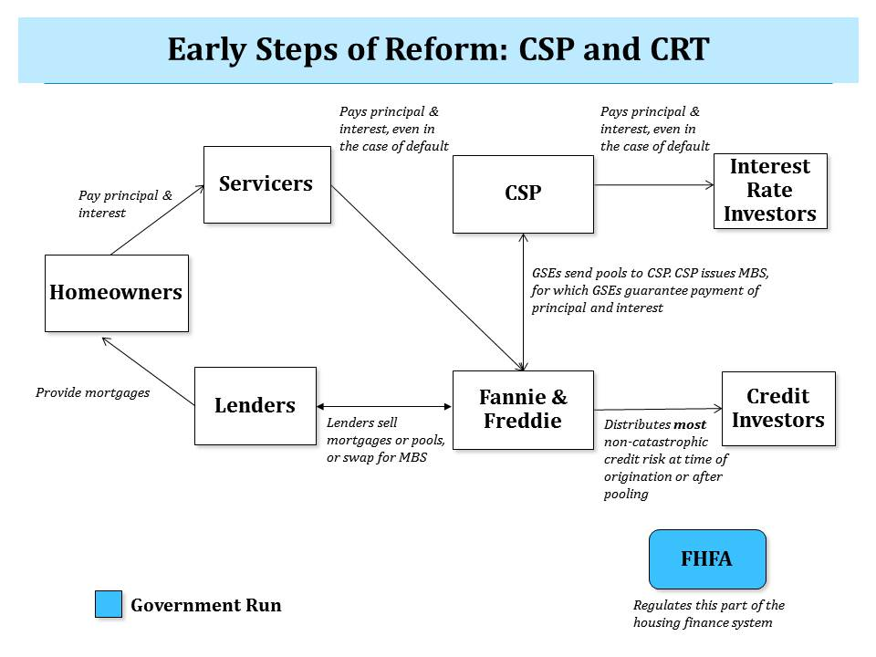
FIRST STAGE OF REFORM: REDUCE RELIANCE ON DUOPOLY
In the aftermath of the financial crisis there is broad consensus that the housing market should reduce its reliance on this duopoly and shift more risk into a competitive private market.
The FHFA has taken three major initiatives to this end:
Gradually shrink the retained portfolio of the GSEs
Transfer the securitization infrastructure into a common securitization platform (CSP)
Disperse credit risk to private investors through credit risk transfers (CRT).
Source: Urban Institute Housing Finance Policy Center

Slide 4
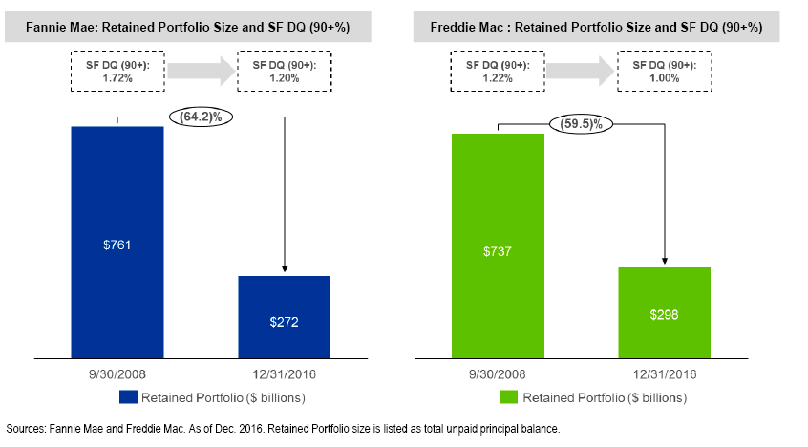
FIRST STAGE OF REFORM II: SHRINK GSE RETAINED PORTFOLIOS
The size of the retained portfolios of the GSEs has shrunk by more than 50% since they were placed in conservatorship on September 6th, 2008.
The combined retained portfolios of the GSEs was $1.498 trillion in September 2008 and dropped to $570 billion by December 2016.

Slide 5
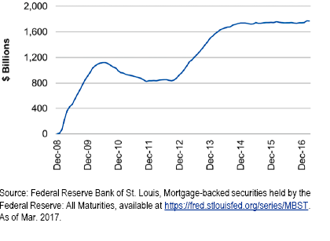
FIRST STAGE OF REFORM III: QE-RELATED PURCHASES OF MBS
The Federal Reserve started adding MBS to its balance sheet in January 2009 as part of Quantitative Easing (QE) programs and currently holds approximately $1.8 trillion on its balance sheet.
Purchases of Agency MBS were initially modest and then increased dramatically in September 2012 as part of QE3, which included purchases of $40 billion per month of Agency MBS.

Slide 6
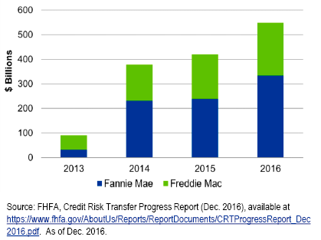
FIRST STAGE OF REFORM IV: GSE CREDIT RISK TRANSFER PROGRAM
The GSE Credit Risk Transfer (CRT) program has transferred a portion of credit risk on over $1.4 trillion of unpaid principal balance (out of an aggregate $4.7 trillion) to the private markets.
There programs, combined with reinsurance and senior/subordinated securitization transactions provide a framework for dispersing a portion of credit risk to the private markets going forward.

Slide 7
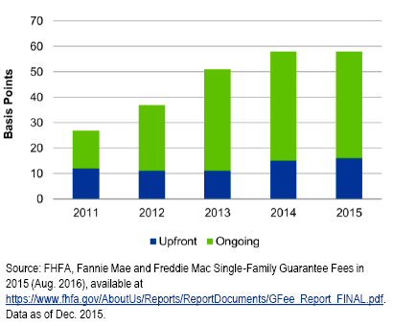
FIRST STAGE OF REFORM V: GSE GUARANTEE FEE INCREASES
The GSEs have improved the credit quality of the loans they are guaranteeing and raised their guarantee fees.

Slide 8
KEY PRINCIPLES FOR THE SECOND STAGE OF REFORM
While the FHFA’s actions do serve to reduce the dependence of the Housing Finance system on the GSEs, there is substantial agreement that more needs to be done in terms of better delineating the roles of the government, the private market, and the tax payer.
There are 3 proposals for this second stage of reform:
Promising Road: Lew Ranieri et al.
Milken: Ed DeMarco et al.
Mortgage Banker’s Association
Common Principles for Reform Proposals
Government Bears Catastrophic Credit Risk: This is central to attracting investors who will accept interest rate/spread risk but do not want exposure to credit risk.
Minimal Level of Taxpayer Risk: To ensure that there is very low likelihood of a government bailout, taxpayer risk is insulated behind private capital from institutions and a mortgage insurance fund
Government Operates CSP: To ensure systemic stability and broad lender access to the secondary market
Minimize Disruption: Use the current system’s infrastructure and processes as much as possible.

Slide 9
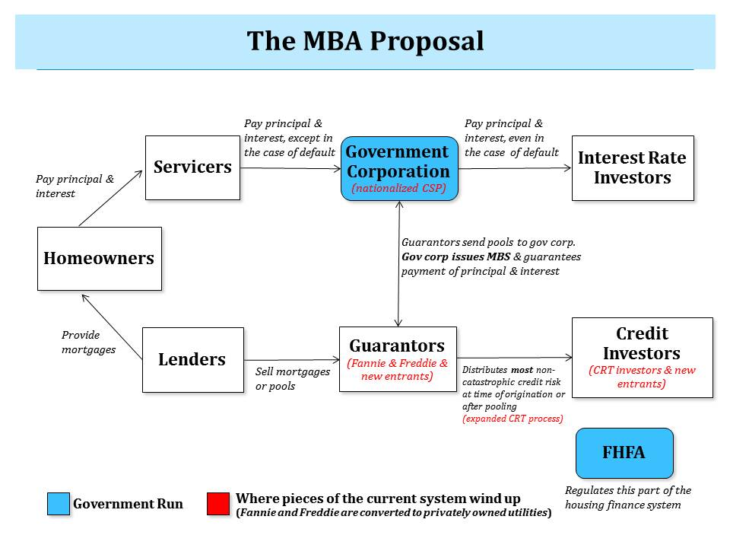
MBA PROPOSAL: EXTENSION OF FIRST STAGE APPROACH
Key aspects of MBA Proposal:
Fannie Mae and Freddie Mac become privately-owned utilities with regulated rates of return.
Newly chartered guarantors are possible.
Non-catastrophic risk continues to be shared with investors through CRT transactions
CSP is a government corporation that issues the securities of Fannie, Freddie and any other chartered guarantors and guarantees timely (but not necessarily full) payment of principal and interest on MBS.
Source: Urban Institute Housing Finance Policy Center

Slide 10
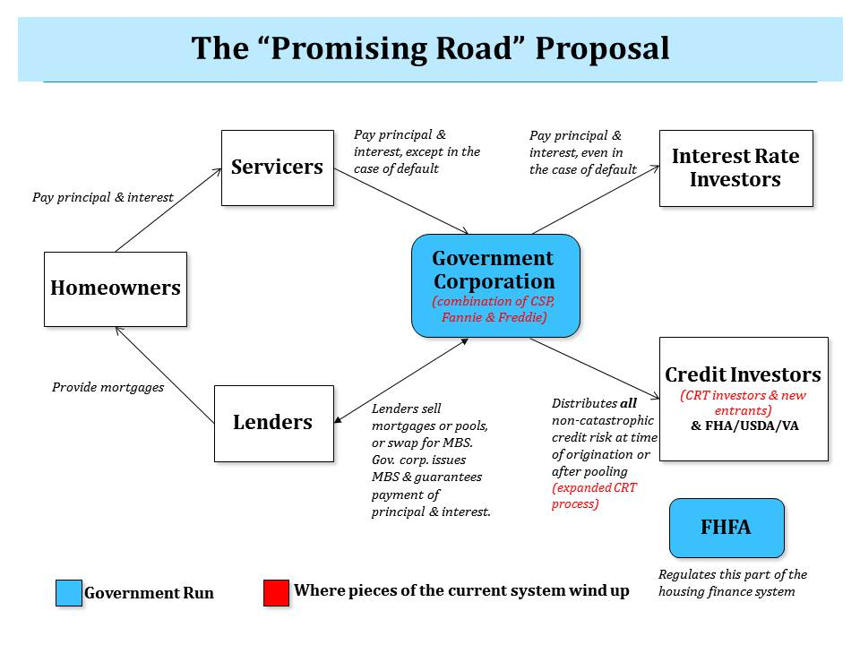
“PROMISING ROAD” PROPOSAL: FURTHER EXTENSION OF MBA PROPOSAL
Key aspects of “Promising Road” Proposal:
Merge Fannie Mae, Freddie Mac and CSP into a single government corporation
This corporation issues government-backed securities, sells off all the non-catastrophic risk on these securities, and guarantees investors timely payment of principal and interest on their investments.
Source: Urban Institute Housing Finance Policy Center

Slide 11
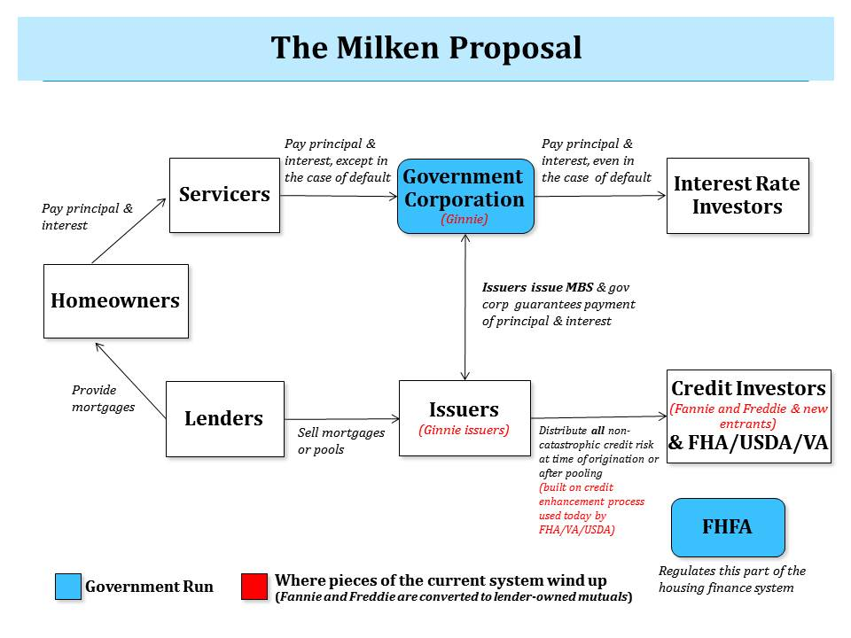
MILKEN PROPOSAL: BUILD ON GINNIE MAE
Key aspects of the Milken Proposal:
Rather than build on CSP and CRT processes, build on Ginnie Mae infrastructure and processes.
Ginnie Mae-approved issuers get credit enhancement from private institutions along with the FHA, USDA, VA and PIH and issue securities through Ginnie Mae. Investors are guaranteed timely payment of principal and interest on their investments.
Fannie Mae and Freddie Mac compete over the management of non-catastrophic credit risk. Their inclination to take on excessive risk is checked by converting them into mutuals owned by the nation’s lenders.
Source: Urban Institute Housing Finance Policy Center

Slide 12
KEY DIFFERENCES ACROSS PROPOSALS
There are two critical differences between the two proposals. Deciding which one to pick is a function of:
Access to Credit: Which system provides the broadest access to mortgage credit?
Taxpayer Protection: Which system provides the best taxpayer protection?
Promotes competition: Which setup best incentivizes healthy competition?
Transition Hurdles: Which is the easiest system to transition to?
 | Comments
Securitization Infrastructure | The Milken proposal relies on Ginnie Mae for the securitization infrastructure while the other two proposals rely on CSP
Treatment of Fannie Mae and Freddie Mac | MBA: Turns GSEs into privately owned utilities that compete with other market participants over the distribution of the system’s non-catastrophic credit risk. Milken: Turns GSEs into lender-owned mutuals that do the same as above Promising Road: Merges GSEs with CSP

Slide 13
DISCLOSURES Important Notes
THIS DOCUMENT IS NOT AN OFFER TO SELL OR THE SOLICITATION OF AN OFFER TO BUY SHARES OF THE FUND. AN OFFERING OF INTERESTS WILL BE MADE ONLY BY MEANS OF A CONFIDENTIAL PRIVATE PLACEMENT MEMORANDUM AND ONLY TO QUALIFIED INVESTORS IN JURISDICTIONS WHERE PERMITTED BY LAW. PAST PERFORMANCE IS NO GUARANTEE OF FUTURE PERFORMANCE.
An investment in the Fund is speculative and involves a high degree of risk. The Fund will have substantial limitations on investors’ ability to redeem or transfer their shares, and no secondary market for the Fund’s shares exists or will develop. All of these risks, and other important risks, are described in detail in the Fund’s Confidential Private Placement Memorandum. Prospective investors are strongly urged to review this Confidential Private Placement Memorandum carefully and consult with their own financial, legal and tax advisors, before investing.
Portions of this document may contain commentary and/or data based on certain current assumptions by Cello Capital Management, LP(“Cello”), which are subject to change at any time, as well as Cello's internal complex calculations. If one or more of these assumptions or calculations is incorrect, the information contained herein may unintentionally be inaccurate.
Certain information contained herein may have been obtained by Cello from third parties. While Cello believes such sources are reliable, Cello has not verified the accuracy of such information and shall not be liable for any errors in such information or for any actions taken in reliance thereon.
Performance results referenced in this document are provided for an investor in Class A1a shares of Cello Fixed Income Master Fund, LP (the “Master Fund”). Unless otherwise noted. Performance reflects all income. Class A1a shares launched on January 1, 2012, and returns for periods prior thereto have been adjusted to reflect the management fees and performance allocations chargeable to Class A1a shares.
The Credit Suisse Fixed Income Arbitrage Hedge Fund Index is a subset of the Credit Suisse Hedge Fund Index that measures the aggregate performance of fixed income arbitrage funds. The Fixed Income Arb Index, which includes mortgage-backed securities, is part of Dow Jones Credit Suisse Hedge Fund Index. The Barclays U.S. Aggregate Index represents securities that are SEC-registered, taxable, and dollar denominated. The index covers the U.S. investment grade fixed rate bond market, with index components for government and corporate securities, mortgage pass-through securities, and asset-backed securities. The Credit Suisse All Hedge Index is an asset-weighted hedge fund index. The S&P 500 is an equity index based on the market capitalizations of 500 large US companies.
This document may also contain certain forward looking statements and projections. Such statements and projections are subject to a number of assumptions, risks and uncertainties which may cause actual results, performance or achievements to be materially different from future results, performance or achievements expressed or implied by these forward-looking statements and projections. Prospective investors are cautioned not to invest based on these forward-looking statements and projections.
This document may contain references to certain internal Cello procedures and policies which are subject to change at any time.
No information or material contained herein may be reproduced, transmitted, displayed or commercially exploited without the prior written consent of Cello. All rights are reserved.

